Slide 1

Reuters-21578 classification
Maksym Shevchenko
AI-1

Slide 2
Input
The documents in the Reuters-21578 collection appeared on the Reuters newswire in 1987.
Dataset consists of 22 data files, an SGML DTD file describing the data file format, and six files describing the categories used to index the data.
The Reuters-21578 collection is distributed in 22 files. Each of the first 21 files (reut2-000.sgm through reut2-020.sgm) contain 1000 documents, while the last (reut2-021.sgm) contains 578 documents.
The files are in SGML format.

Slide 3
File structure
<!DOCTYPE lewis SYSTEM "lewis.dtd">
<REUTERS TOPICS="YES" LEWISSPLIT="TRAIN" CGISPLIT="TRAINING-SET" OLDID="19419" NEWID="3001">
<DATE> 9-MAR-1987 04:58:41.12</DATE>
<TOPICS><D>money-fx</D></TOPICS>
<PLACES></PLACES>
<PEOPLE></PEOPLE>
<ORGS></ORGS>
<EXCHANGES></EXCHANGES>
<COMPANIES></COMPANIES>
<UNKNOWN></UNKNOWN>
<TEXT>
<TITLE>U.K. MONEY MARKET SHORTAGE FORECAST AT 250 MLN STG</TITLE>
<DATELINE> LONDON, March 9 - </DATELINE>
<BODY>The Bank of England said…</BODY>
</TEXT>
</REUTERS>

Slide 4
Input dataset creation
1) Get dictionary of topics and text from .sgm files
2) Process text by removing:
- special symbols
- typographical symbols
- punctuation marks
- multiple spaces
3) Replace numbers with special word “int”
4) Convert text to lowercase
5) Write result to .csv file

Slide 5
Pre-classification processing
1) Read dataset using pandas
2) Lemmatize text using nltk.stem.WordNetLemmatizer
3) Remove stopwords using nltk.corpus.stopwords.words('english’)
4) Vectorize text using bag of words (sklearn.feature_extraction.text.CountVectorizer)
5) Normalize text using sklearn.feature_extraction.text.TfidfTransformer
6) Split dataset to train and test data
After these steps perform classification using the pre-build in sklearn models

Slide 6
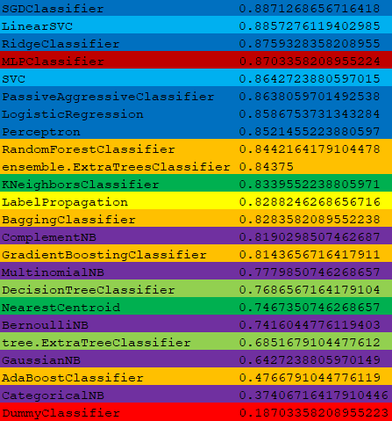
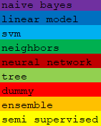
Results

Slide 7
Sources
GitHub Repository
Dataset

